Slide 1
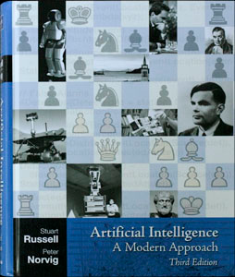
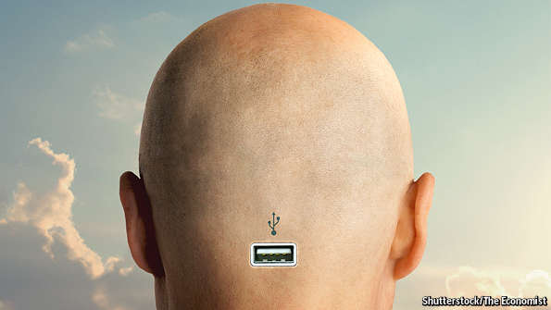
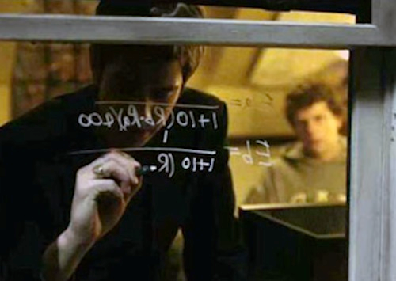
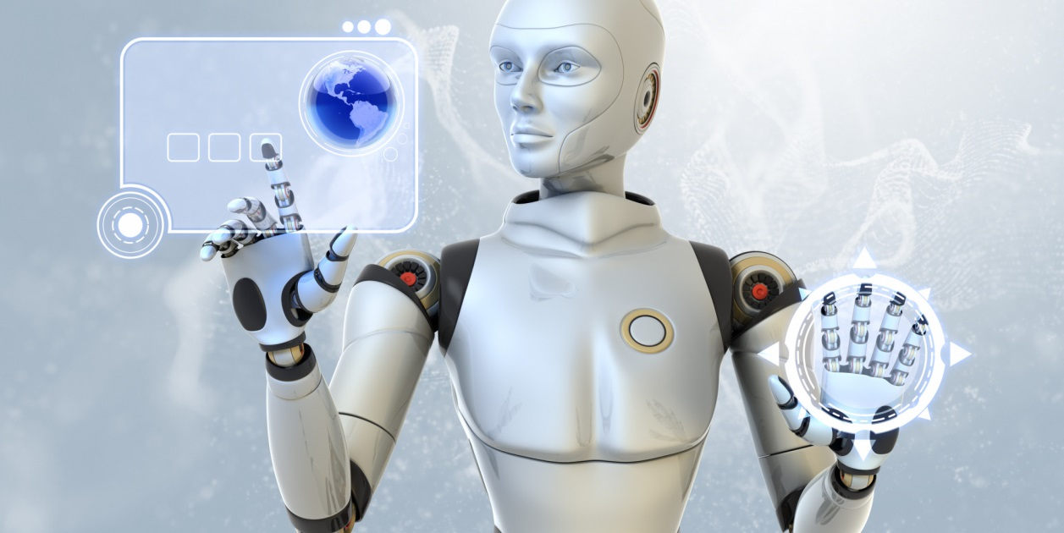

Artificial Intelligence: Class Trailer
ai

Slide 2


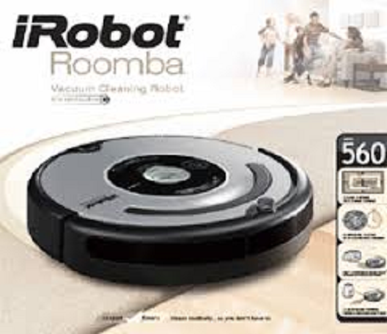
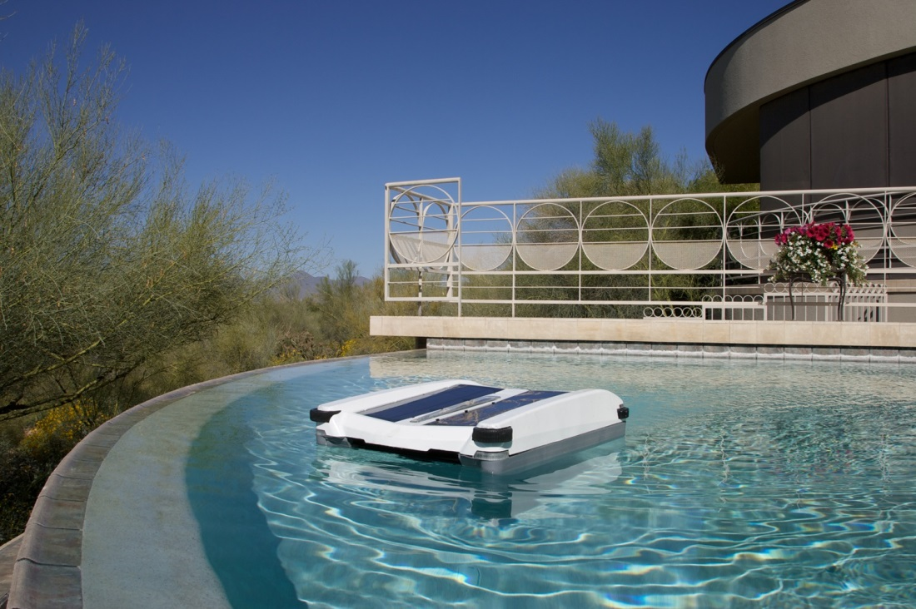
AI Topics – Intelligent Agents
Are they Intelligent?
How can we tell?

Slide 3
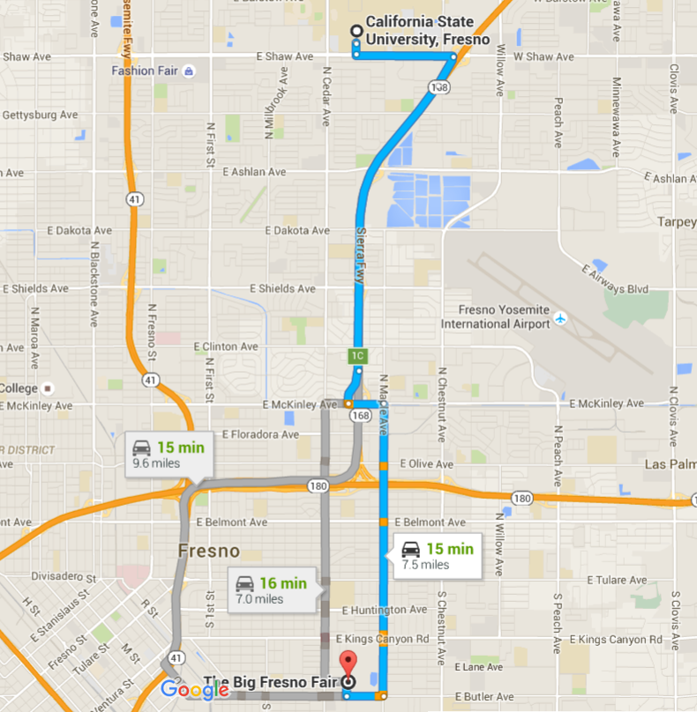
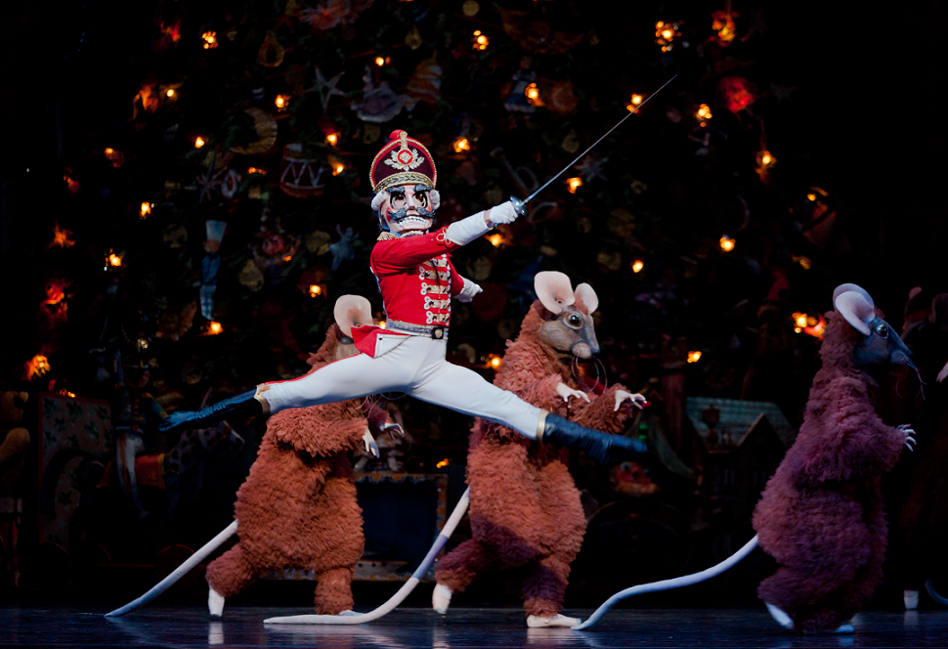
AI Topics - Abstraction
Hello, World!

Slide 4
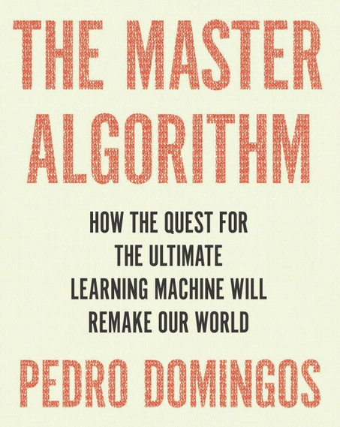
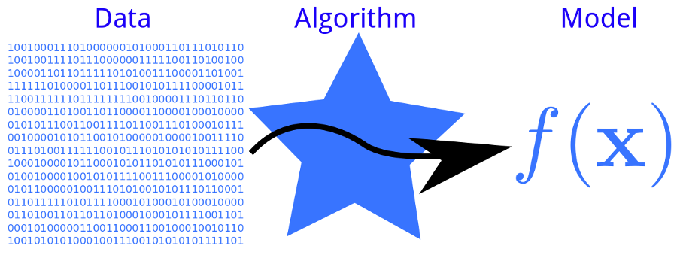
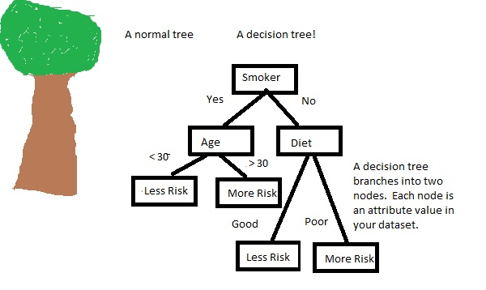
AI Topics - Learning
Learning

Slide 5
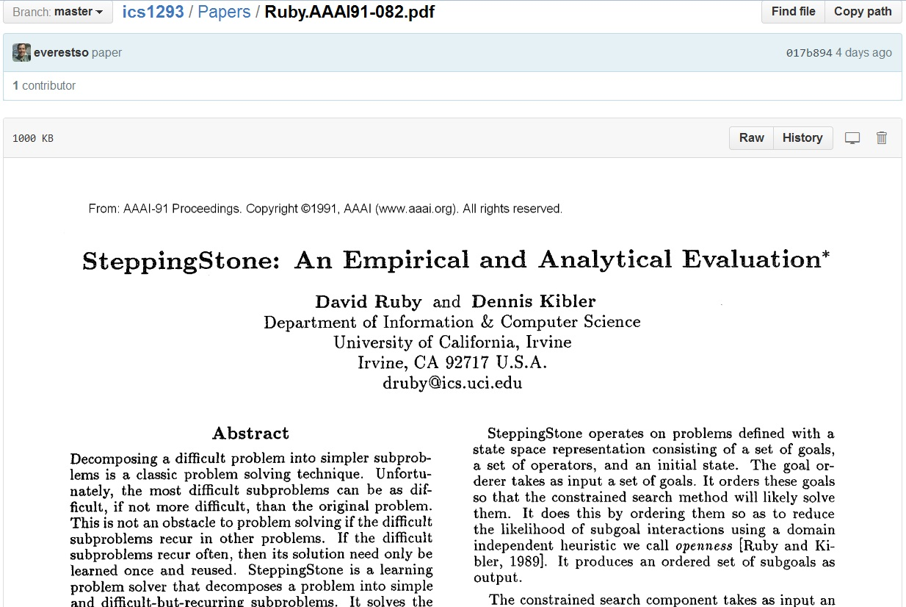
Artificial Intelligence

Slide 6
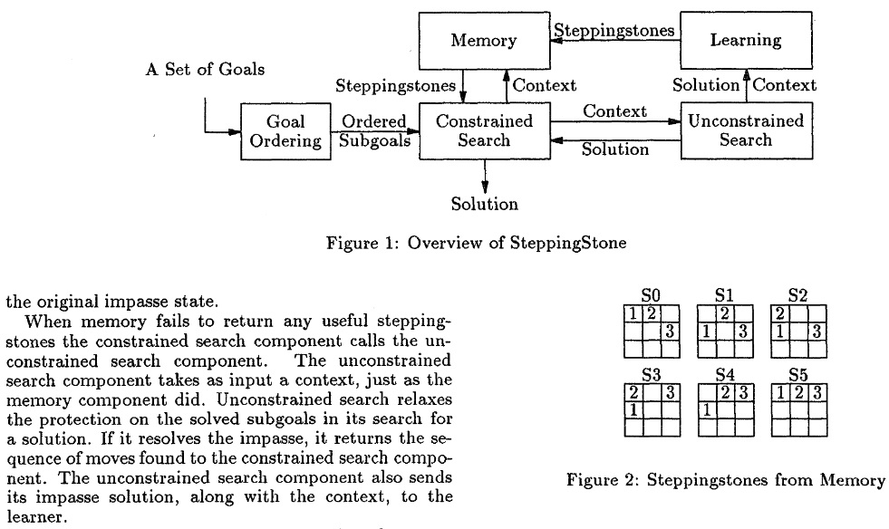
Tile Sliding Domain

Slide 7
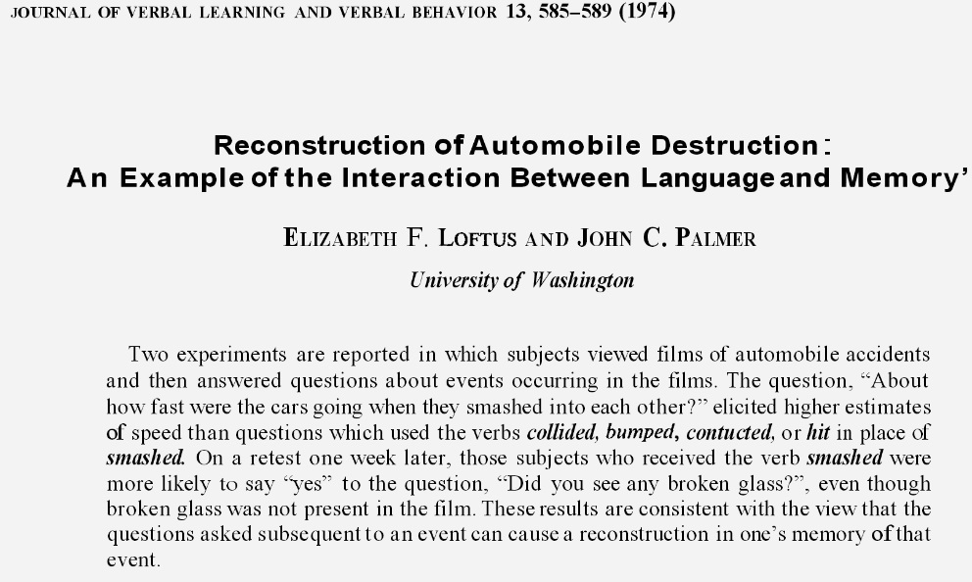
Memories & Learning

Slide 8
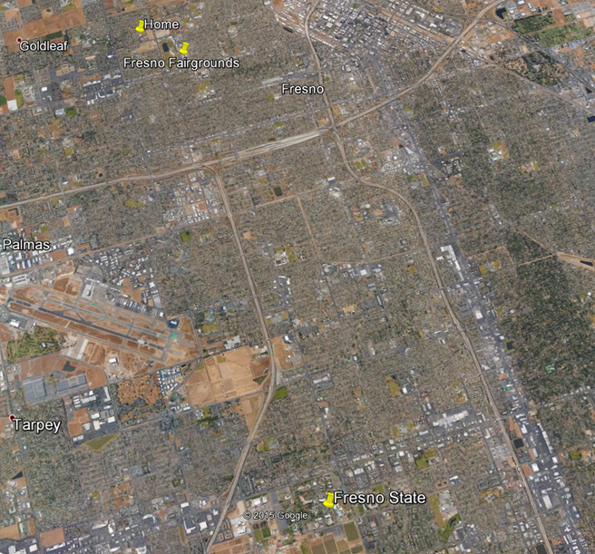
North

Slide 9
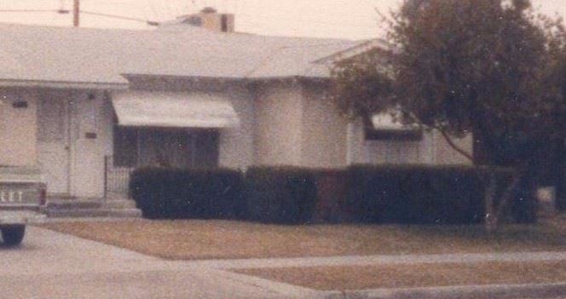
Mazes
Home Hedges

Slide 10
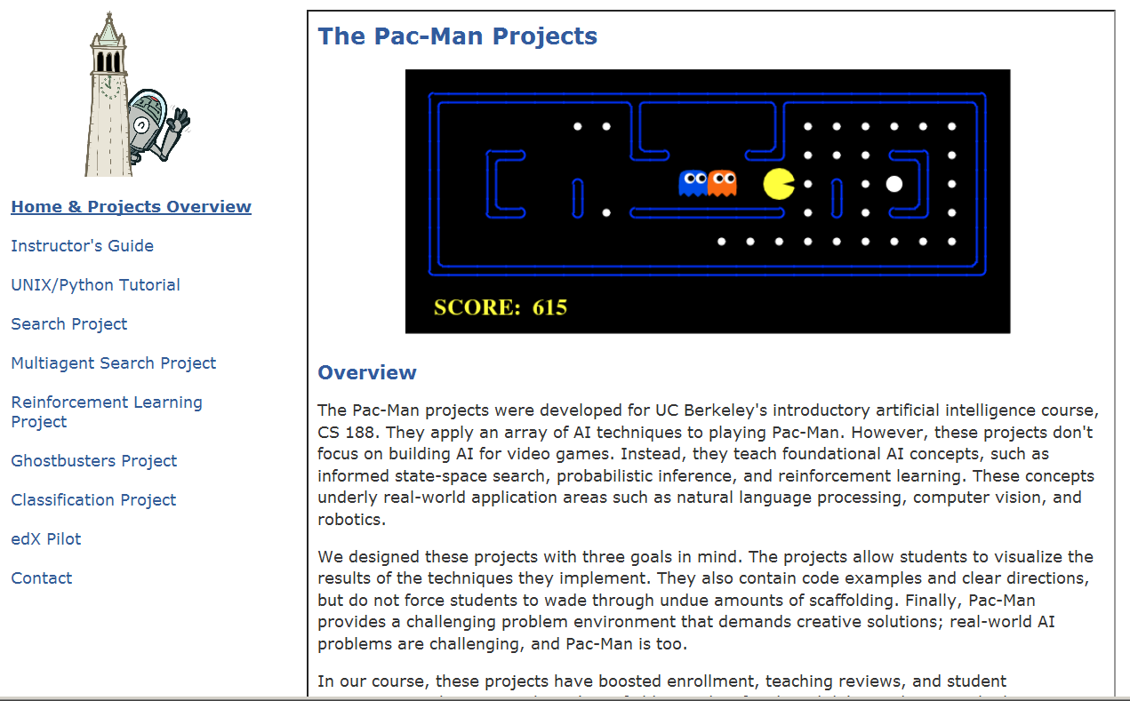
Pacman Projects

Slide 11
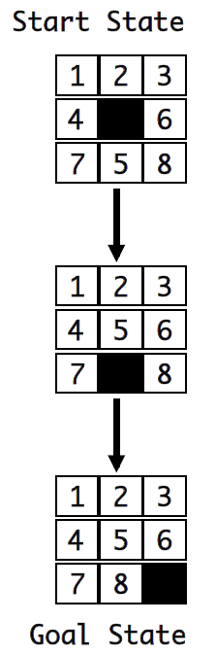
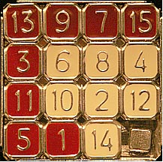
Tile-Sliding Puzzle

Slide 12
Textbook
The 22nd most cited computer science publication on Citeseer (and 4th most cited publication of this century).

Slide 13
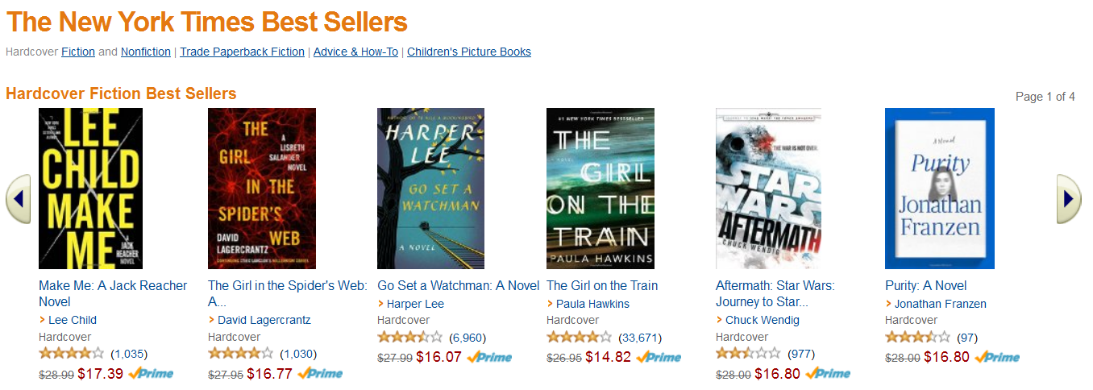
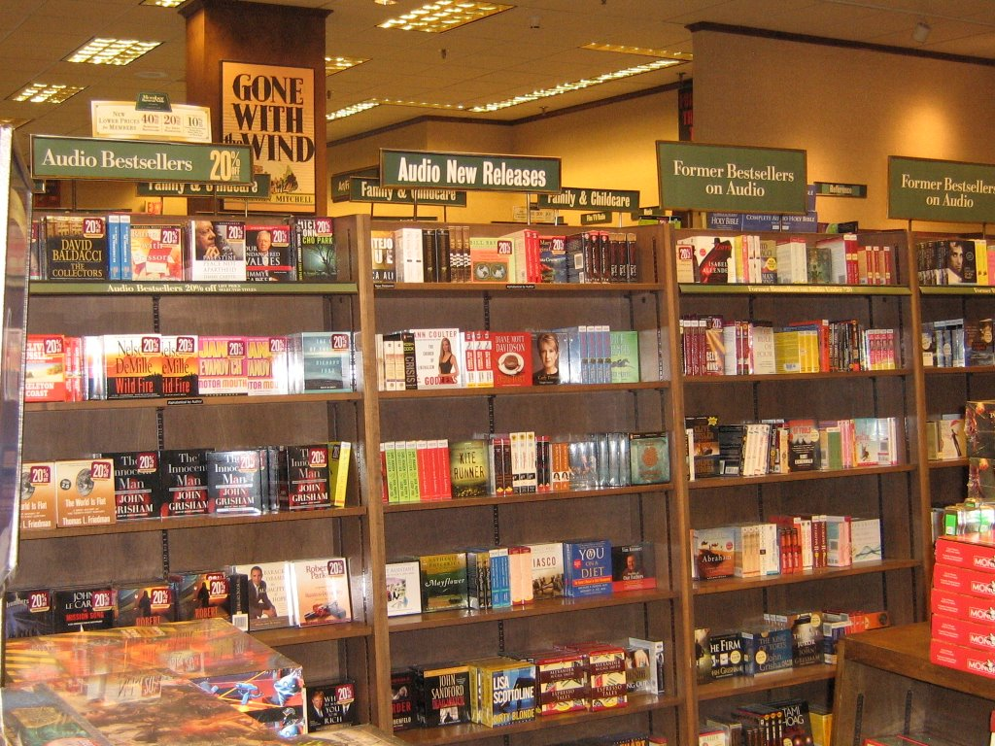

Best Sellers w/ Hardcover Fiction!
Frequent Visits

Slide 14
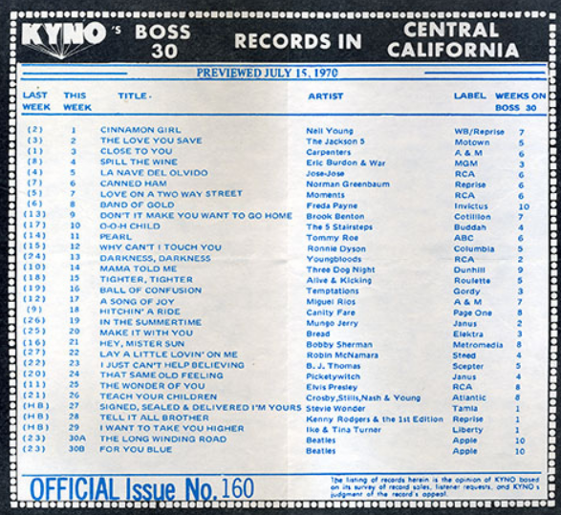

Slide 15
Best Sellers w/ Hardcover Fiction!
Frequent Visits

Slide 16
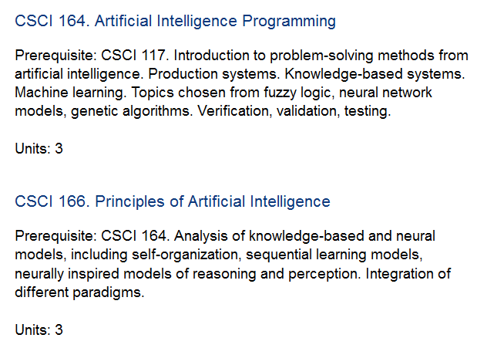
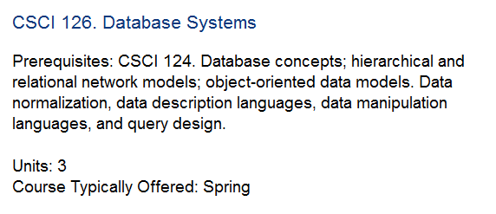
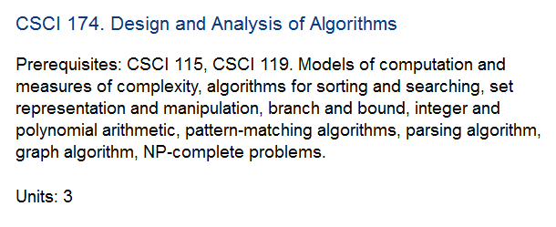
Computer Science

Slide 17


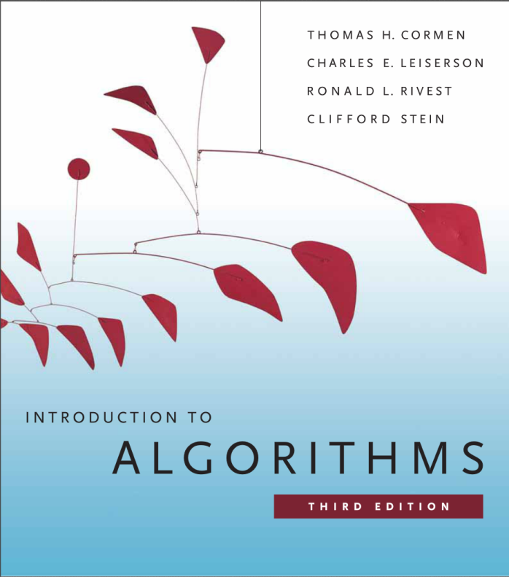
Computer Science

Slide 18
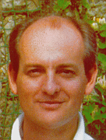
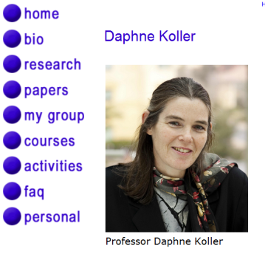
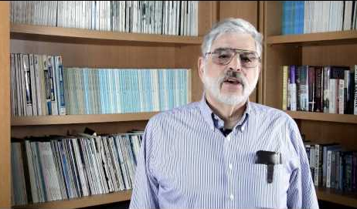

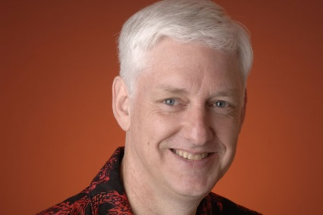

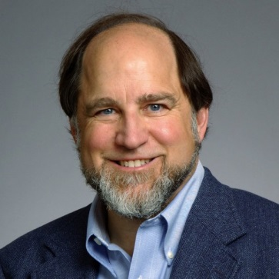

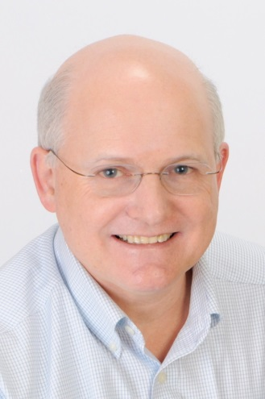

Computer Science

Slide 19
Grading
Period | Presentations/Examinations/Assignments | Points
Various | Presentations/In-Class | 100
 | Python/Git (Assignment 1) | 100
 | Problem Solving w/ State-Space Search (Assignment 2) | 100
 | Problem Solving in Games (Assignment 3) | 100
 | Personal Project | 100
 | Midterm | 200
 | Final | 300

Slide 20
In-Class Presentations
Class Introductions/AI Interests/Project Ideas
Final Presentations

Slide 21
Assignments (Programming)
Assignment 1: Git/Python Basics
Assignment 2: State-Space Search
Assignment 3: Games
Personal Project

Slide 22
Tests
Midterm (20%)
Final (30%): May 18 @ 3:30-5:30p

Slide 23
Personal Project
Choose a Problem
Words With Friends
Utilize AI Algorithm to find solutions w/ Python.
Plan to share code with class.

Slide 24
Textbook
The 22nd most cited computer science publication on Citeseer (and 4th most cited publication of this century).

Slide 25
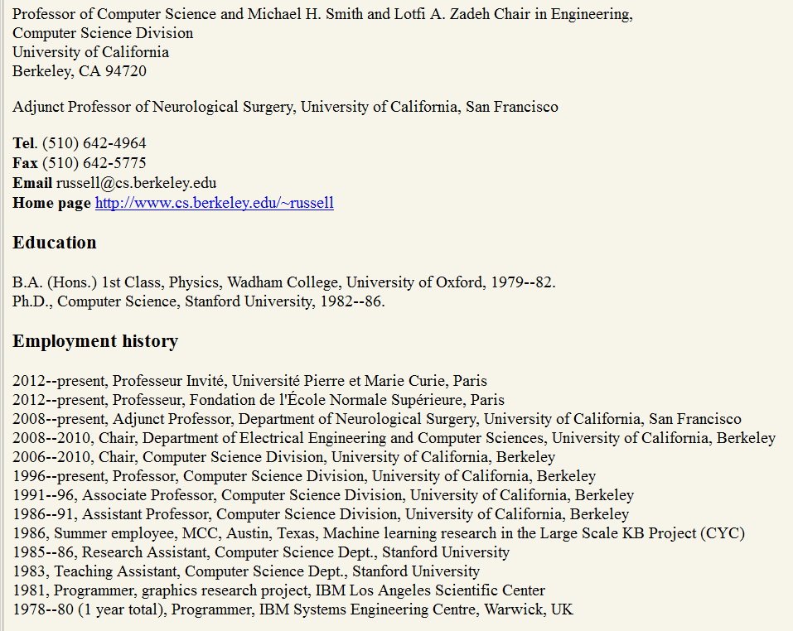
Dr. Stuart Russell

Slide 26
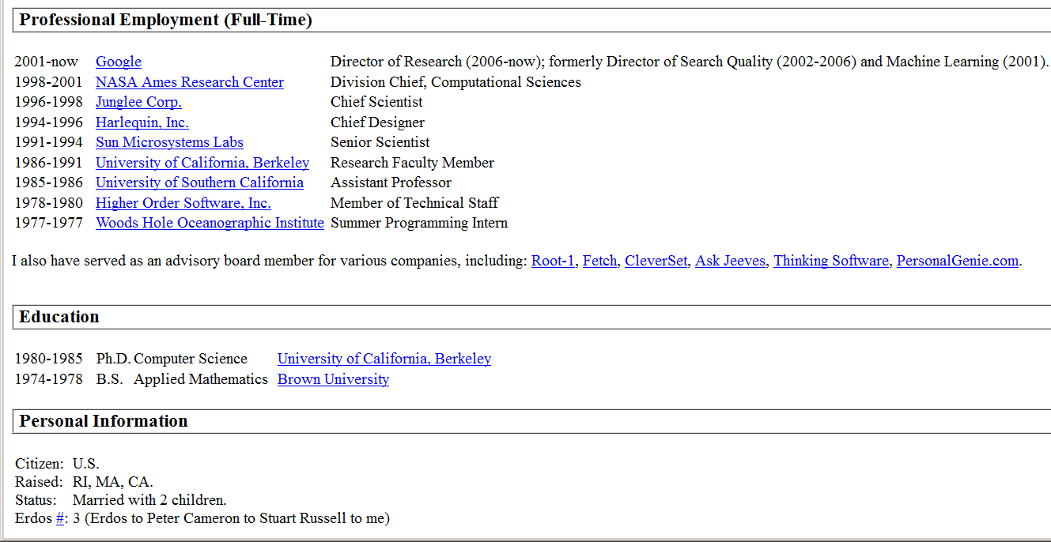

Dr. Peter Norvig

Slide 27
Pacman Projects

Slide 28

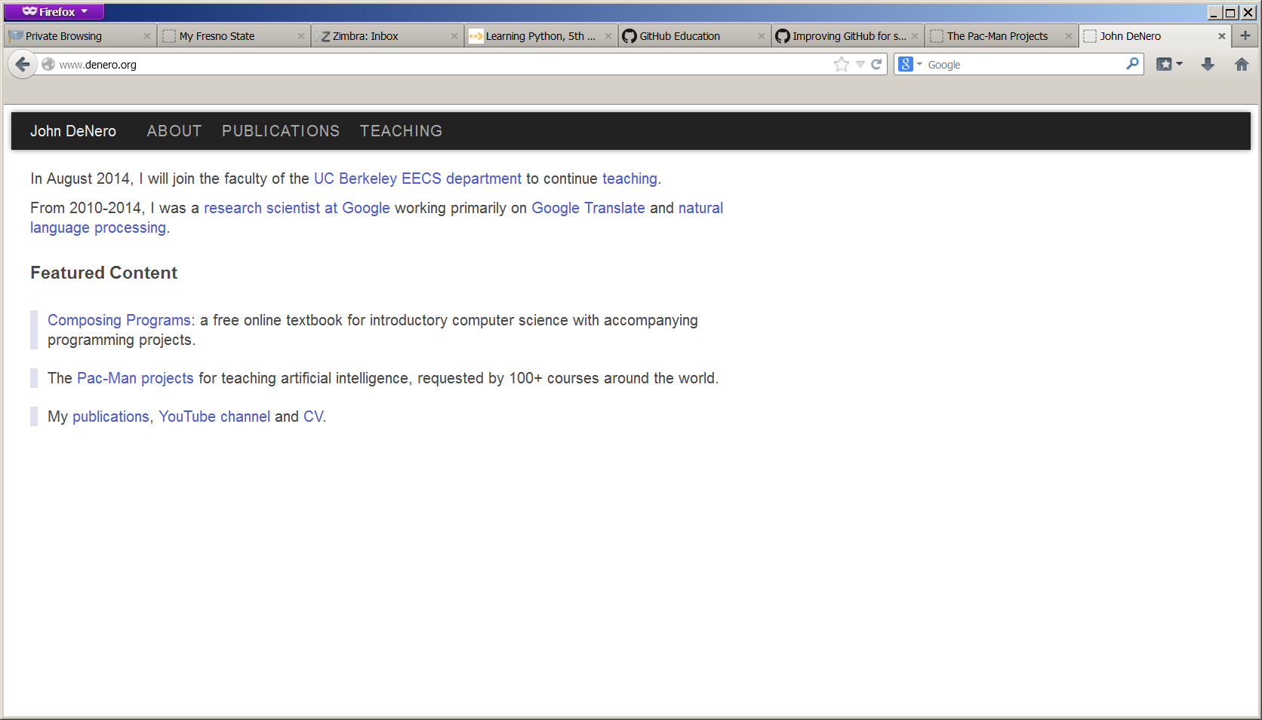
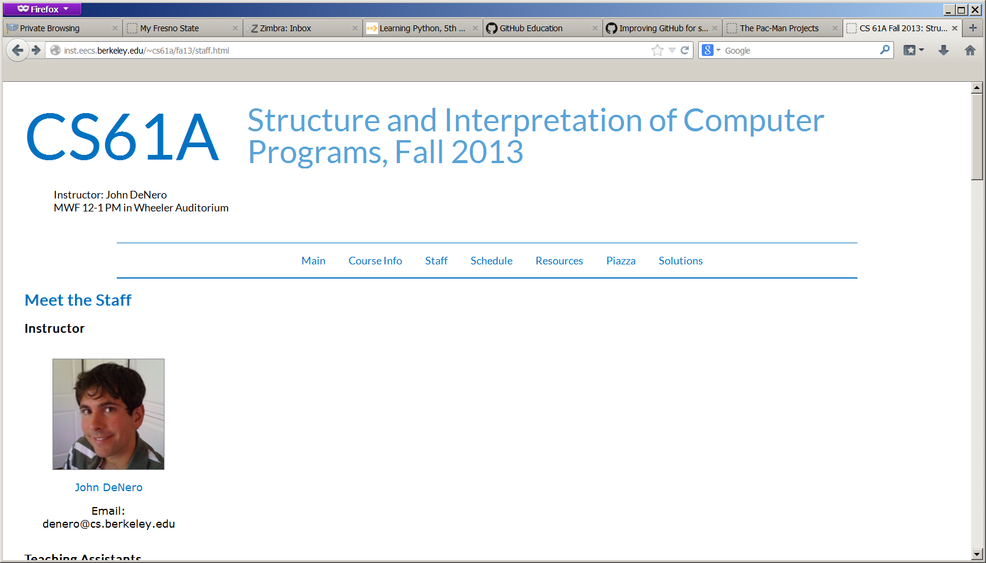
Pacman Projects: Dr. John DeNero
John DeNero

Slide 29
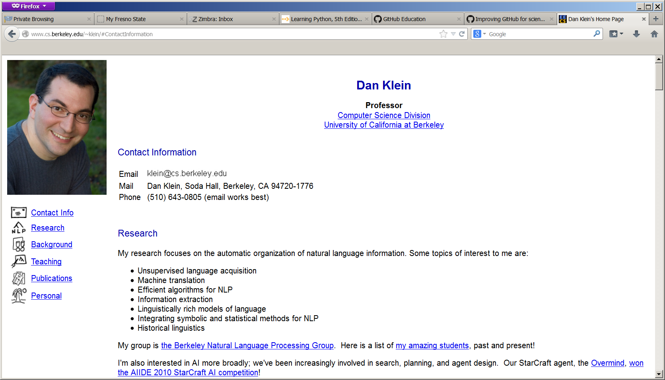
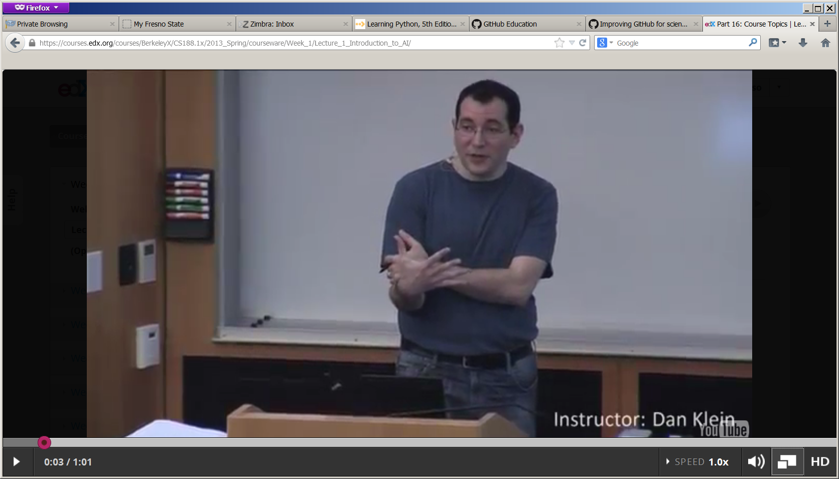
Pacman Projects Dr. Dan Klein

Slide 30
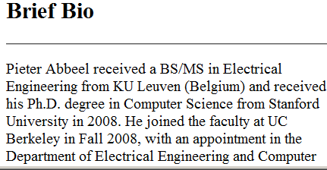
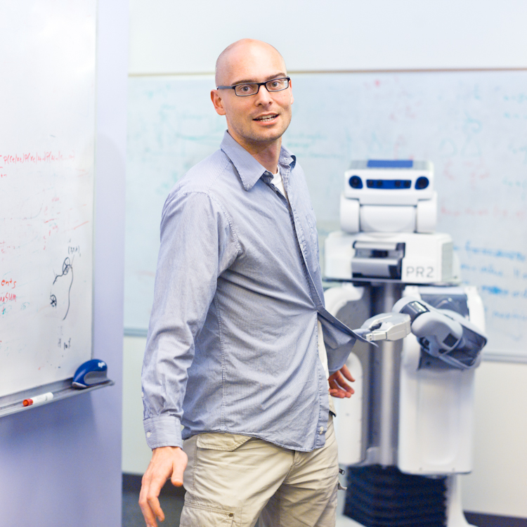
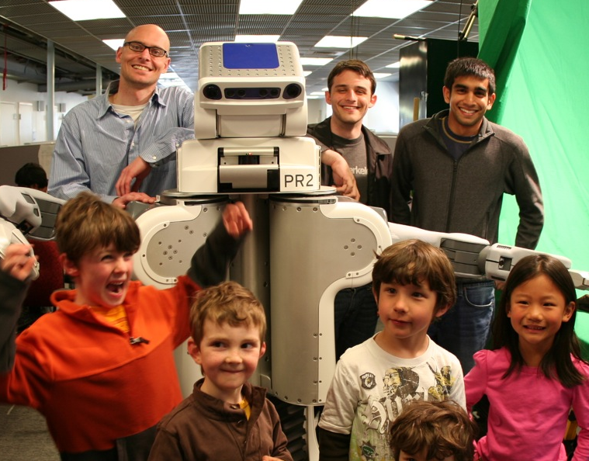
Pacman Projects Dr. Pieter Abbeel

Slide 31
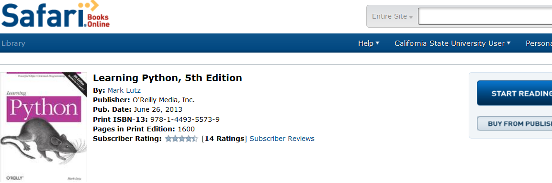
Additional Materials

Slide 32
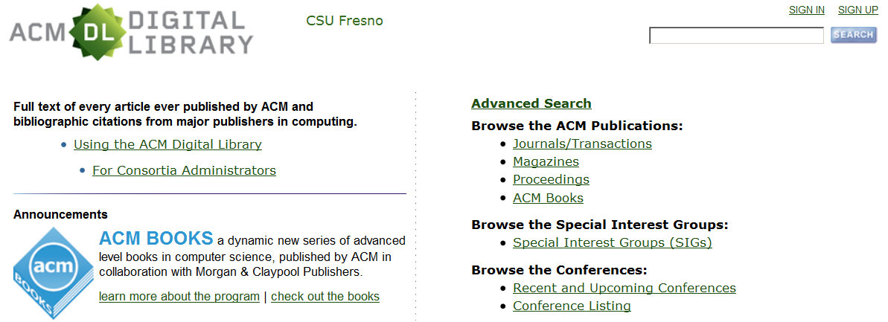
Additional Materials

Slide 33
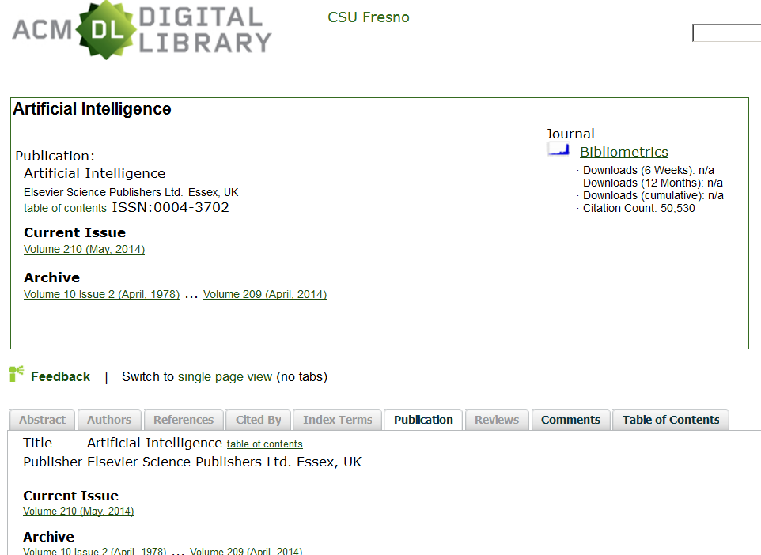
Additional Materials

Slide 34
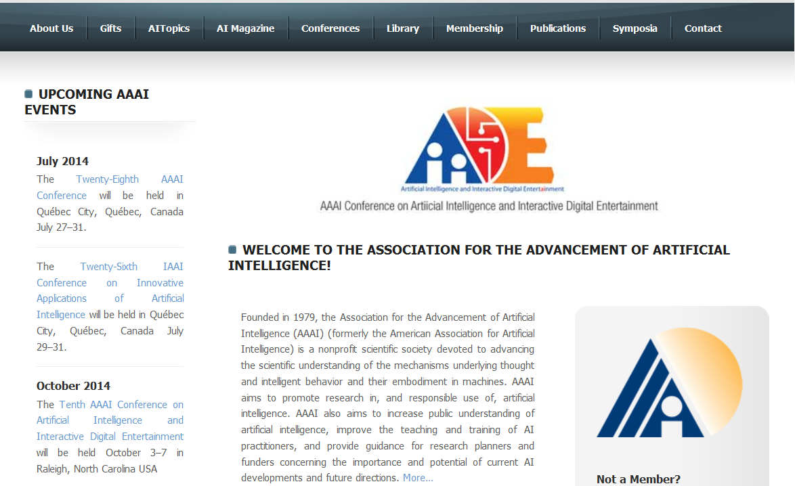
AAAI.ORG More Later

Slide 35
Tentative Course Schedule
Chapters 1-10

Slide 36

Chapter 1 What is AI?
What is Intelligence?

Slide 37
Chapter 1 What is AI?
Introduce Science of Artificial Intelligence
History of AI

Slide 38
Git/GitHub/Python 2.7
Introduce Assignment 1:
Git Basics
Install/Configure Git/GitHub
Send me your GitHub Information
Get access to private Class Repository
Python Introduction

Slide 39
Chapter 2: Intelligent Agents
Agents operate in world
Is Agent Intelligent?

Slide 40
Chapter 2: Problem Characteristics
Examine problems
Problems people solve
Problems not currently solved by computers
Develop characteristics for describing problems.

Slide 41
Chapter 3: State-Space Search
Uniformed Search
Heuristics
Informed Search
A*

Slide 42

Assignment 2: The Maze
Uniformed Search
Heuristics
Informed Search

Slide 43
Chapter 4: Beyond Classical Search
Additional Search Methods
Beam Search
Genetic Algorithms
Incomplete Knowledge
And/Or Trees

Slide 44
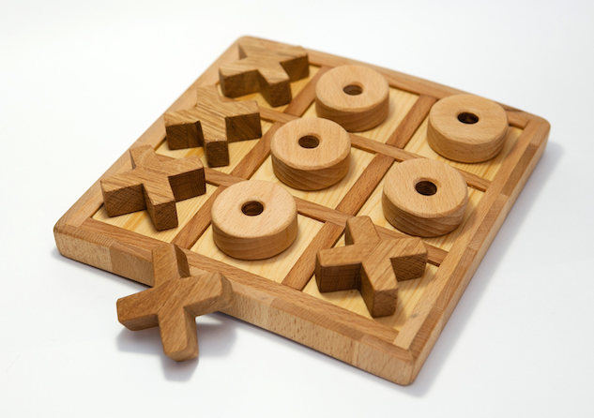
Chapter 5 Adversarial Search
Multiplayer Games
Minimax
Alpha Beta Cutoff

Slide 45
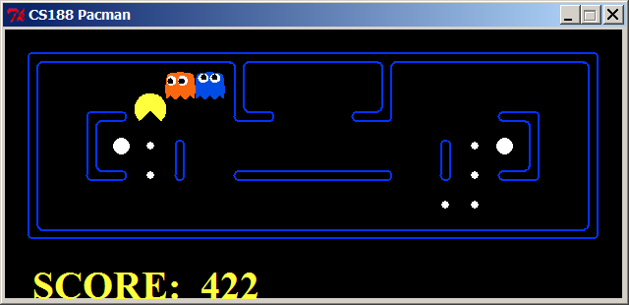
Chapter 5/Assignment 3: Adversarial Search
Minimax, Alpha Beta, Expectimax

Slide 46
Midterm
Chapters 1-5

Slide 47
Class Introductions / Project Ideas

Slide 48
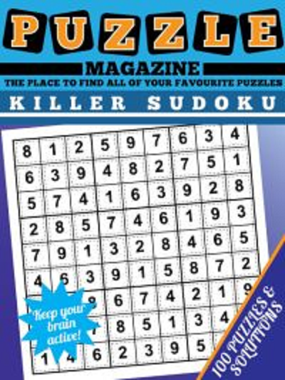
Chapter 6: CSP
Constraint Satisfaction Problems
AC-3 Algorithm
Cutsets
Etc…

Slide 49
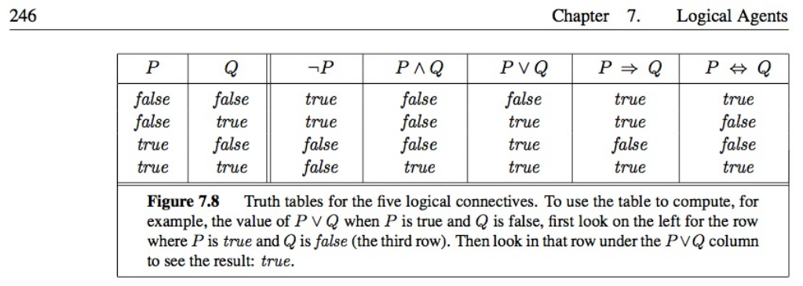
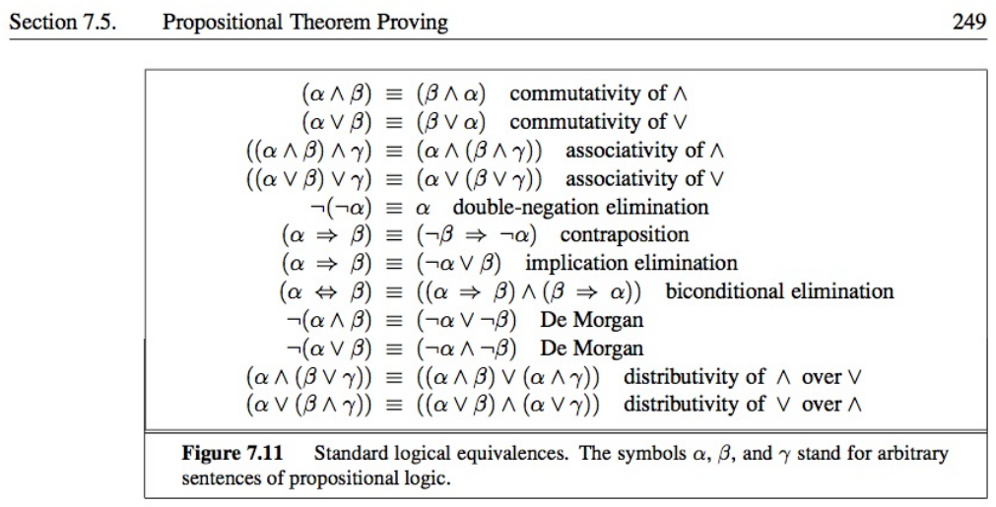
Chapter 7: Logical Agents
Propositional Logic

Slide 50


Chapter 7: Logical Agents w/ Wumpus World
Wumpus World

Slide 51

Chapter 8: FOL
First-Order Logic

Slide 52

Chapter 8: FOL

Slide 53
Chapter 8: FOL
FOL – Fun!
FOL – Powerful!
FOL:
Algorithms much more complex
Reasoning is quickly intractable!!

Slide 54

Chapter 9: Inference
Reasoning w/ FOL

Slide 55


Chapter 10: Planning
Planning with Logic
Shakey’s World

Slide 56


Chapter 10: Planning w/ Blocks World

Slide 57
Class Presentations

Slide 58
Final
Chapters 1-10

Slide 59
Grading
Period | Presentations/Examinations/Assignments | Points
Various | Presentations/In-Class | 100
 | Python/Git (Assignment 1) | 100
 | Problem Solving w/ State-Space Search (Assignment 2) | 100
 | Problem Solving in Games (Assignment 3) | 100
 | Personal Project | 100
 | Midterm | 200
 | Final | 300

